Slide 1

“Application For Grocery Delivery”
Task - 4

Slide 2
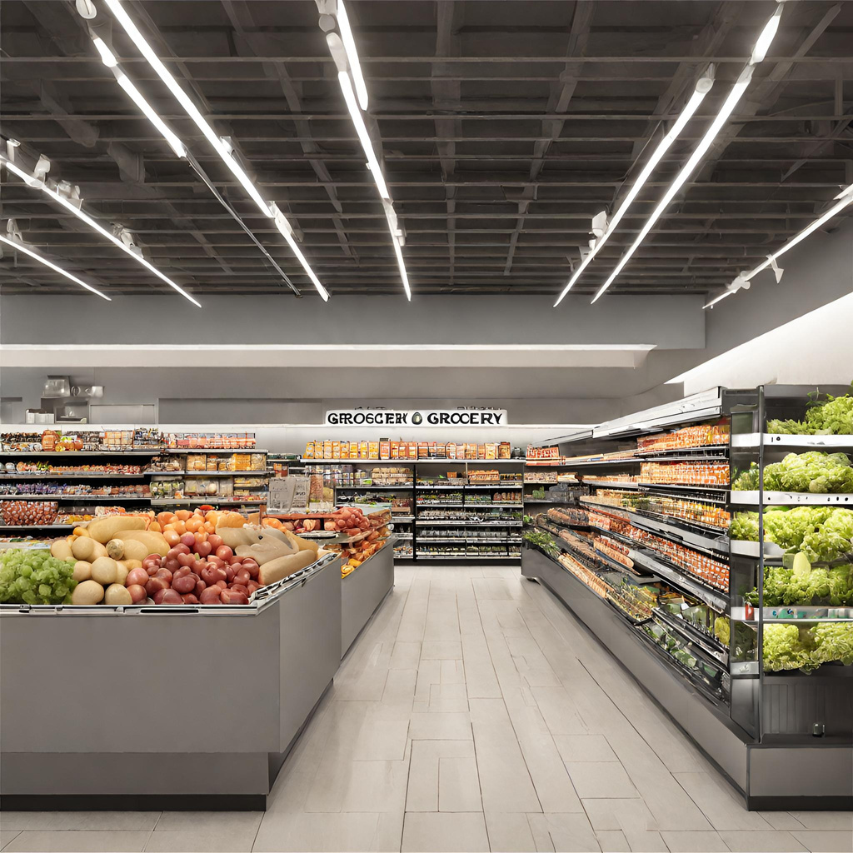
Our project introduces an innovative Grocery System, combining cutting-edge technology with industry best practices to enhance the grocery shopping experience. With a focus on operational efficiency, customer satisfaction, and inventory optimization, our system aims to modernize the grocery retail sector. By embracing the trends in online and offline shopping, we empower customers and store owners alike, creating a more sustainable and profitable grocery ecosystem.
Application For Grocery Delivery
▪
au910020104301 |  | CC2
au910020104036 |  | CC2
au910020104008 |  | CC2
LMS Username
Name
Batch
AKSHAYA G
RAJASURIYA M
ARUN S

Slide 3
Step-WiseDescription
1. API Documentation:
- Understand the API by reviewing documentation for endpoints and parameters.
2. Development Environment:
- Set up your development environment with necessary tools and dependencies.
3. Project Setup:
- Create a new project or navigate to your existing project.
4. Dependency Installation:
- Use a package manager to install required libraries, such as Axios.
5. UI Component Creation:
- Develop components to display data retrieved from APIs.
6. API Call Implementation:
- Use the chosen library to make API calls, handling requests and responses.
7. Dynamic UI Update:
- Modify components to dynamically update based on API data.
8. Testing and Deployment:
- Thoroughly test the application and deploy it to production, monitoring for any issues.

Slide 4

Task Summary
To Integrate backend APIs into the grocery application frontend for enhanced functionality. Begin by understanding API documentation and setting up the development environment. Create UI components for visualizing grocery data and implement API calls using libraries like Axios. Ensure dynamic UI updates based on the received data. Thoroughly test the application for reliability and deploy to production. Prioritize robust error handling, optimize performance through techniques like caching, and strike a balance between real-time updates and minimizing unnecessary API calls for optimal efficiency.

Slide 5

Submission Github
Github Link

Slide 6


